Slide 1



The Lagos State Primary Health Care Board Public Financial Management Assessment Report
Preliminary Findings
September 2025

Slide 2

Background
Background
Approach
Findings
The Lagos State government shows a commitment to health, with the Primary Health Care (PHC) financing seeing significant growth over the years. This investment, however, must be balanced against the realities on the ground. This assessment aims to provide a comprehensive analysis of the Lagos State Primary Health Care Board's (LSPHCB) financial management systems.
Pinpoint specific challenges within the public financial management (PFM) system that hinder effective service delivery.
Purpose of the Assessment
Assess the effectiveness of current planning, budgeting, and accountability processes.
Develop targeted, actionable recommendations to strengthen the LSPHCB's PFM system and ensure that funds translate into tangible health outcomes for the community.
Notes:
.

Slide 3


Methodology
Background
Approach
Findings
This assessment was conducted using a mixed-methods approach to provide a holistic and evidence-based analysis of the public financial management (PFM) landscape.
Scope of the Assessment
Data Collection Approach
Key Informant Interviews (KIIs): Qualitative data was gathered through structured interviews with a wide range of stakeholders, including:
Planning official
Budgeting official
PHC Officers-in-Charge (OICs)
State Level
End-to-end PFM system of the Lagos State Primary Health Care Board (LSPHCB), from budget preparation to fund release and oversight.
Document and Data Review: Quantitative data was abstracted from key financial and strategic documents, including:
Annual Operational Plans (AOPs)
Quarterly Business Plans
Budget reports and financial records
Facility Level
In-depth assessments at 12 Primary Health Care (PHC) facilities across the state to understand on-the-ground challenges and financial practices.
PHCUOR Scorecard Analysis: We reviewed the national PHCUOR Scorecard to identify overarching gaps and recommendations for the state.
Facility Audits: A checklist was used to assess financial records and documents at each of the 12 PHCs.

Slide 4


Governance & Strategic Framework
Background
Approach
Findings
Established Laws
Lagos has a law establishing the State Primary Healthcare Board (SPHCB), gazetted.
Lagos health sector reform law did not specifically mention PHC under one roof; however, the SPHCB domesticated the PHCUOR policy into the State law.
Lagos State achieved an 82% score in the PHCUOR Scorecard, ranking it 19th nationwide. It excels in five key pillars: Operational Guidelines, Funding Sources, Human Resource for Health, Legislation, and Governance and Ownership, but it performs poorly in MSP.
Recommendations from PHCUOR Scorecard 6
Amend Operational guidelines to allow the transfer of RMNCAEH+N programmes to the SPHCB
Develop strategies for training LGHA on the roles and responsibilities of the SPHCB and the LGHA.
What can be done?
to accommodate and regulate additional programmes.
*Support the development and facilitation of capacity-building trainings for the Board and the LGHA.
Sources * Implementation Guidelines for PHCUOR 2018
* PHCUOR Scorecard 6 2022
* https://laws.lawnigeria.com/2019/04/04/health-sector-reform-law/
Notes:
.

Slide 5

Governance & Strategic Framework
Background
Approach
Findings
Availability of Strategic Documents
Implementation status of the strategic documents
There is no costed MSP in the state.
The challenge lies in the implementation of the captured activities as budgetary allocations are often inadequate due to delays in the development of the strategic documents, release of funds, as well as competing priorities in the state.
Implementation, irrespective of the delays in releasing funds, is mainly possible because of donor interventions in the state.
Facility level 2025 AOPs were not implemented or leveraged in the development of their business plans. Facility-level participation in planning processes needs to be strenghtened.
 | Lagos
PHC Strategic Plan | s
Annual Operational Plan | p
Costed MSP | s
s No
p Yes
Lagos SPHCB does not have a dedicated PHC strategic plan; it rather provides input into the overall state Strategic Health Plan, which it then adopts.
Addressing concerns about budget releases for the implementation of the Annual Operational Plan (AOP) is essential. There is a need to reprioritize budget allocations for the interventions outlined in the strategic documents.
This will require a careful assessment of competing priorities and a focus on allocating resources based on strategic objectives and desired outcomes. Additionally, it is crucial to gain political support and involve all stakeholders to ensure successful implementation and adherence to operational guidelines.
Recommendations from PHCUOR Scorecard 6 (2022) Report
There was no costed MSP sighted*
Incorporate MSP and Investment plans into the State Strategic Health Development plan
Reflection

Slide 6
LSPHCB Budget Performance
Background
Approach
Findings
Approved Budget and Releases Trend (2020 - 2024)
Insights
Under-release is chronic until 2024.
2024 is a positive inflexion. Nearly full cash-backing of capital indicates better cash management or prioritization in the year.
Why Releases Fall Short
Cumbersome approval processes: Multiple layers of sign-off (Treasury, MoF, PS, LSMOH) slow down fund release.
Unpredictable timelines: No clear release calendar — cash backing can take anywhere from days to months.
Procurement bottlenecks: Centralized supply and contractor engagement at times, introduce delays before facilities receive inputs.
* Budget Performance
*47%
*95%
*31%
*70%
*69%
Insights
Personnel budgets are consistently well-funded, often exceeding approvals. However, this is not sufficient to cover the salaries of all PHC staff or to recruit an adequate number of personnel needed to provide PHC services in the state.
2023 stands out — releases were 31% higher than approved, likely due to salary adjustments or arrears.
Unlike capital, personnel spending is a state priority with reliable funding.
* Budget Performance
*105%
*131%
*116%
*86%
*118%

Slide 7
LSPHCB Budget Performance
Background
Approach
Findings
Approved Budget and Releases Trend (2020 - 2024)
Insights
There is a chronic under-release of overhead funding.
Implications for PHC
PHCs struggle to cover utilities, fuel, and supplies, directly affecting service delivery.
Staff present cannot function effectively without running costs.
Limited funds for operational decisions means dependence on higher levels for small needs.
* Budget Performance
*70%
*48%
*62%
*31%
*72%
Recurrent Budget
*85%
*15%
*87%
*
Releases
*100%
Budget Performance
Approved Budget

Slide 8
LSPHCB Budget Performance
Expenditure Trend (2021 - 2025)
Expenditure rose steadily from ₦1.03B in 2021 to ₦7.92B in 2024.
Fourfold increase by 2024, driven largely by salary obligations and new program commitments.
Spending growth is not necessarily efficiency — without capital/overhead growth, the increase reflects heavier wage bills, not stronger PHC capacity.
The majority of 2024 expenditure went to personnel, crowding out other critical needs.
Overheads & utilities underfunded
Drugs & supplies marginal: Very little allocation went into medicines and program activity costs, limiting service readiness.
Current expenditure structure sustains staff but underfunds operations and investments — PHCs risk becoming “staffed but under-equipped.”

Slide 9
LSPHCB Budget Performance
Background
Approach
Findings
Expenditure Trend (2021 - 2025)
Staff salaries rose sharply in 2024, while spending on drugs, activities, and maintenance declined. Overall, the budget trend shows a shift in priorities toward personnel over operational costs.

Slide 10
LSPHCB Budget Performance
Background
Approach
Findings
Expenditure Trend (2021 - 2025)
Utilities spending stayed flat, while facility maintenance and capital projects showed sharp fluctuations. Notably, capital projects peaked in 2022, declined in 2023, and then rose significantly in 2024.

Slide 11

LSPHCB Budget Performance
Budget Line | Insights & Gaps Identified | Proposed Improvement Plan
Overall | Budget execution credibility low (under-releases common) No costed MSP to guide PHC financing Disconnect between PHC business plans and state-level budget process | Develop and adopt a costed MSP for Lagos PHCs as a benchmark for financing needs Institutionalize quarterly PHC budget execution scorecards (approved vs released vs spent) Formalize a budget planning loop where PHC business plans feed directly into the state’s MTEF and annual budget cycle Deploy a real-time digital budget tracking tool that links allocations/releases with: → Facility business plan activities → Service delivery outputs (e.g., outreach sessions, essential drug availability, staff presence). This shifts monitoring from “money spent” to “money spent → service delivered.”
Capital | Releases <50% in most years Infrastructure projects delayed; weak prioritization of PHC service needs Execution bottlenecks despite existing contracting system | Score all PHC capital projects against service readiness benchmarks before approval Ensure PHC projects have a dedicated capital sub-line to protect against reallocation
Overhead | Allocations not fully released or delayed Facilities depend on DRF/IGR to cover gaps Weak oversight of use of overhead at facility level | Enforce timely quarterly release protocols for PHC overhead budgets Define a minimum protected overhead threshold per facility, aligned to size and workload Strengthen accountability through the digital tracking tool, linking overhead use to planned activities (e.g., supervision visits, community mobilization, routine maintenance)
Personnel | Funding covers salaries but staffing still inadequate Maldistribution leaves many PHCs understaffed Payroll inefficiencies reduce fiscal space | Implement biometric payroll verification to clean ghost workers and free resources Apply a needs-based staffing formula tied to catchment population and workload Use targeted contract-based hiring for critical cadres in underserved LGAs, funded from payroll savings and BHCPF Establish a joint HRH financing committee (LSPHCB, Civil Service Commission, MoH) to align budgeted posts with PHC gaps and redeployment priorities

Slide 12
Ideal State Level Budget Preparation Process
Background
Approach
Findings
Notification (Call-Circular) letter from the SMBP
Each unit, department and program prepares a budget
Consolidated budget submitted to the SMOH
SMOH holds budget discussion with SMBP
Budget defence at the SHOA followed by investigation
Budget approval
Typical Budget Preparation process at the state level
Aug
Sep/Oct
Nov/Dec
Dec
SMBP, State Ministry of Budget & Planning
SMOH, State Ministry of Health
SHOA, State House of Assembly

Slide 13

LSPHCB Budget Preparation Process
Background
Approach
Findings
Typical approach to budget preparation in Lagos State Primary Health Care Board
Notification (Call-Circular) letter
Collection of data from all units and departments.
Draft consolidated by the Budget & Planning unit.
LSPHCDB management team reviews draft. Adjustments made to fit within ceilings; some items dropped or scaled back.
Budget submission and defence at the SMBP
Budget approval
MEPB presents consolidated state budget (including LSPHCDB’s).
At the department level:
Call Circular Issuance: The Ministry of Economic Planning & Budget (MEPB) issues an annual budget call circular with ceilings and guidelines.
LSPHCDB receives envelope allocations (often under tight ceilings).
The previous budget is analyzed by a budget committee to decide on projects to be continued and projects that have been concluded.
In LSPHCB, these steps are carried out and coordinated by the Budget and Planning department.
Jun
Jul
Aug
Sep/Oct
Weaknesses in the Budget Development Process: ​
PHCs develop costed annual business plans, but these are not systematically rolled up into the Board’s submission to MEPB. The plans often remain planning tools for facilities, not binding budget inputs.
MEPB ceilings dominate the process, so even when PHC needs are captured, they get compressed or dropped to fit fiscal limits.
Even when budgeted, cash rationing causes reduced releases for overhead and capital, making PHC business plans hard to execute.
PHC business plans are not fully costed against actual budget lines, so monitoring is fragmented.
The Budget preparation process has so far not been standardized. Budgets are often developed without first completing the Annual Operational Plan (AOP)
The 2025 facility-level AOP was not implemented, used to access funding, or used as the main strategy document from which their business plans were drawn.
Information triangulation:
The office of Financial Management and the Budget and Planning confirm that the budget templates used by each unit and department are properly filled out and analyzed by the budget unit.
Returned submissions are infrequent, but the common reasons for return are a lack of budget realism and cases of budgets not well justified
The budget process begins in mid-year, runs through September, and approval is obtained from the appropriate authority by November at the latest.

Slide 14
SPHCDA Level-Access to Funds
Background
Approach
Findings
Programs/ activities are planned
Memos are raised for the programs/activities by program managers
HCH presents memos to the governor at the executive meeting
The governor approves and money is released
Requests routed through the Permanent Secretary to the HCH
Tracking of Budget using a template sent to LGA M&E
Budget Performance review
At the board level, fund disbursement is memo-based
*
AOP performance is to be reviewed at the LSPHCB.
SPHCDA should drive tracking of project implementation, to ensure alignment with the budget.
Quarterly, discussions chaired by the DPRS should be held at agency meetings to address challenges of fund disbursement.
Extra-budgetary expenditure is also memo-based.
*
Program officers sometimes struggle to write effective memos for their activities, leading to rejections and delays in the approval and disbursement of funding. Enhancing their skills in this area can significantly improve project implementation and completion.
Timelines for the approval of memos are highly unpredictable, ranging from a day to a year.
*
The release of funds is dependent on the timely submission and approval of the budget, which is often hindered by delays and bureaucratic processes. This can result in both delayed implementation and, in many cases, the rushed execution of activities in the Annual Operational Plan (AOP). When there are delays in releasing funds, the Board relies heavily on donors and implementation partners to carry out the AOP.
Additionally, there is currently no standardized structure or format for developing memos.

Slide 15

Memo Development Process
Step 1
Initiation of Need
Department/Unit identifies a financial requirement. Officer drafts memo with justification and attachments.
Step 2
Internal Review
Memo reviewed by HOD and DFA for technical and financial vetting.
Step 3
Ministry of Health Approval
Memo is endorsed by the Permanent Secretary and Commissioner for Health.
Step 4
Treasury Processing
MoF/STO evaluates against cash availability and spending priorities. A cash-backing order is issued.
Step 5
Disbursement of Funds
Funds are released to LSPHCDB. PHCs receive funds/goods
Step 6
Accountability & Reporting
Finance Department prepares retirement documents and reports to MoF and Auditor General.
Weak or incomplete memos slow down approvals.
Bottlenecks from the return of memos for correction due to the quality gap
Timelines are erratic and can range from days to months.
Funding is unpredictable due to rationing.
Observed Challenge
Develop and roll out a uniform memo format with clear guidance on required attachments (e.g., cost breakdown, justification, budget reference).
Build the capacity of program staff and accountants at LSPHCDB on memo writing, financial justification, and documentation standards.
Streamline memo workflows for memo preparation and review timelines at each approval point (DFA, PS, Commissioner, Treasury).
Create a simple dashboard or logbook to track and monitor every memo (date raised, approvals, cash backing, disbursement) so that delays can be flagged and bottlenecks identified and resolved.
Proposed Improvement Plan

Slide 16
Proposed Improvement Plan
Background
Approach
Findings
Financial Reporting
Findings
Weaknesses
Personnel Reporting
Payroll managed centrally by State Treasury/Establishments Office.
Reports focus only on headcount and salary expenditure.
Consistently reported and reconciled (strongest stream).
Overhead & Capital Reporting
Reports mainly reflect budget approvals vs releases, not actual utilization.
Expenditure data is weak because funds often converted into in-kind supplies (fuel, drugs, equipment) instead of direct disbursement.
Contractors submit completion certificates but not always linked back to budget reporting.
PHC Facility-Level Reporting
Facilities maintain cashbooks, bin cards, and manual ledgers.
Financial data submitted inconsistently to LGAs and LSPHCDB.
Reports highlight delays, with some PHCs lacking basic templates or tools.
BHCPF Reporting
Where Direct Facility Financing (DFF) exists, PHCs submit retirements of funds to LSPHCDB.
Retirements are better structured (dual signatories, receipts, SOPs), but integration into overall Board reporting remains weak.
Different streams (payroll, treasury, facilities, BHCPF) report separately with no consolidation.
Focus on “what was approved vs released” rather than actual expenditure and utilization.
Paper-based ledgers and vouchers dominate, causing delays and inaccuracies.
Some facilities submit reports, others do not.
Returns to MoF and the Auditor General are often late.
No unified reporting framework: Absence of a commitment and cash release register to track funds end-to-end.
Enforce the mandatory use of the state's financial reporting templates by all PHCs, LGAs, and Board departments to ensure consistent application.
Set strict monthly deadlines for PHCs and quarterly consolidation at the Board, with supervisory follow-up for late submissions.
Create a single register at LSPHCDB that brings together all streams — personnel, overhead, capital, BHCPF — into one financial report.
Gradually digitize template submissions (e.g., simple Excel/PFM-lite dashboard) to speed up collation and improve accuracy.
Require reports to show alignment with PHC business plans and the State AOP, so spending can be tracked against planned activities.

Slide 17
Procurement Processes
Procurement guided by state laws, SOPs, and standardized price lists (reviewed quarterly).
Step 1
Needs Identification
Departments and PHCs request items (commodities, equipment, works).
Consolidated at LSPHCDB against budget lines.
Step 2
Use of Pre-Approved Vendor List
Lagos operates a system of pre-qualified vendors, approved by the State Procurement Agency.
Requests are matched to this vendor pool for efficiency.
Step 3
Approval & Clearance
DFA vets requests, ES/Board Chair signs, then forwarded to MoH (PS & Commissioner).
MoF/Treasury confirms cash availability before purchase orders are issued.
Step 4
Vendor Engagement & Supply
Vendors supply goods/services based on LPO/PO.
PHCs usually receive commodities directly instead of cash transfers.
Step 5
Verification & Payment
LSPHCDB verifies delivery through store records or facility confirmation.
Vendors submit invoices → payments processed via Treasury.
Even with pre-approved vendors, cash-backing and approvals still cause long waits.
Limited facility input: PHCs rarely procure directly; needs may be under- or mis-supplied.
Some vendors delay delivery due to bureaucracy or cash-flow bottlenecks.
Observed Challenge
Expand pre-approved vendor categories and enforce service-level agreements.
Introduce procurement dashboards to track timelines from request → approval → delivery → payment.
Vendor performance scorecards: Rate vendors quarterly on timeliness, quality, and compliance.
Ensure every procurement request references the AOP/business plan line item for accountability.
Proposed Improvement Plan
17

Slide 18
Improvement Plan
Background
Approach
Findings
Quality Assurance Systems
LSPHCB uses dual audits and monthly performance tracking for oversight. These financial records are reviewed regularly.
Procurement reforms at the LSPHCB have improved PFM performance.
Text
Assessment Opinion
Deploy real-time financial and performance dashboards.
Strengthen facility-level monitoring and reporting capacity.
Institute regular feedback loops to address gaps identified during audits.
Insight
Service quality is affected by top-down planning and limited autonomy.

Slide 19

Health Facility Financial Management
Background
Approach
Findings

Slide 20

Governance and Accountability
Background
Approach
Findings
Findings from the Facilities
Half of the assessed facilities reported limited autonomy in managing resources, as financial decisions were centralized at higher levels. In some PHCs, unit heads were unable to exercise discretion over routine expenditures, which weakened local governance structures and blurred accountability lines. Although central oversight was intended to promote control, it inadvertently constrained facility-level ownership and responsiveness.
It will be good to build a complete financial management system domiciled at the Facility level, whereby the facility can get its own funds, use the funds, account for the funds and produce very transparent reports. This will enable facilities to be ready for direct funding without funds meant for them being passed to other entities before they reach them.
What can be done?
Advocate for delegated authority for minor expenses.
Establish clear accountability frameworks.
Notes:
.

Slide 21
Background
Approach
Findings
Financial Management – Health Facility
Accounts:
Operational account.
All internally generated revenue
BHCPF
Drugs account
SDRF (signatories- OiC and Pharmacist)
DRF:
The SDRF committee meets monthly to discuss needs.
There is a documented SDRF operational guideline in use.
Facilities procure their SDRF drugs from the Lagos Medical Store.
A voucher is raised by the committee, and purchases are made quarterly.
A trained pharmacist manages facility SDRF.
Selling price is determined using the SDRF operational guideline.
There is no recorded case of stockout of tracer medicines.

Slide 22

Health Facility Autonomy and Authority (1/3)
Background
Approach
Findings
Decisions on Spending Facility Funds
Most PHCs lack institutional systems for financial data: Facilities could not clearly identify all their funding sources, nor provide expenditure data during the assessment.
Implication
Creates low visibility of resource flows at facility level.
Weakens accountability and complicates reconciliation between approved budgets, releases, and actual utilization.
Undermines evidence-based planning and monitoring of PHC performance.
What can be done?
Develop a standard operating procedure to guide PHCs in financial management.
Build the capacity of the Facility managers on financial management and reporting
Roll out standardized facility financial registers/templates to capture funding sources and expenditures.
Digitize reporting using simple, low-cost tools (Excel, mobile-based apps) for PHC use.
Train officers-in-charge and PHC accountants on financial record-keeping and reporting.
Link facility-level financial data to business plans and the State AOP, to strengthen planning and accountability.
The majority of the facilities assessed stated that expenditures were centrally approved and managed by the MOH, limiting their ability to respond quickly to urgent needs. Some PHCs reported that OICs had to personally handle pressing expenses because they lacked direct access to funds. This centralised financial approach was widely viewed as a barrier to responsiveness and accountability.
For activities/expenses outside the approved business plan, approvals are usually obtained from LGA seeking the go-ahead to execute the need.

Slide 23

Community Participation in Health Facility Management
Background
Approach
Findings
Facilities in the state collaborate with the WDC and community members on the management of the facility.
The facilities typically invite the WDC to their monthly meetings, where they discuss financial matters and issues affecting the facility and the community.

Slide 24


Improvement Plan
Background
Approach
Findings
Cross-Cutting Constraints to PHC Functioning
Assessment Opinion
Insight
The facility OiCs in the state adopt different approaches when faced with insufficient funds.
Some prioritize expenditures based on predetermined criteria, while others adhere strictly to the allocated limits.
Some of the facility OiCs reallocate funds within the PHC facility's budget to address emerging needs.
The requirement to seek approval from the SPHCB through the LGA for activities not included in the business plan may indicate inflexibility in the decision-making process. This could result in delays and bureaucratic hurdles in responding to emerging needs or unforeseen circumstances at the facility level.
The need to obtain approval may limit the autonomy of the PHC facility. This may impede the ability of facility managers and staff to respond promptly to the peculiar needs of their communities or take advantage of local opportunities for improving the quality of health care provided.
It is understood that the approval process is in place for accountability and to prevent fund mismanagement. However, removing this rigidity, though with an internal mechanism for accountability put in place, will increase the facility’s autonomy.
Establish Monitoring and Evaluation Mechanisms:
Institute M&E systems to track the implementation of activities not captured in the business plan. An accountability framework can also be integrated into the system
This will assess the effectiveness of the decision-making process and identify areas for improvement, ensuring accountability and transparency in resource utilization.

Slide 25

Inadequate and Delayed Financing
Background
Approach
Findings
Cross-Cutting Constraints to PHC Functioning
20% of the facilities assessed reported that their third-quarter business plans had not yet received formal approval at the time of the interview, a situation that resulted in delays in commencing planned activities and hindered the timely implementation of priority interventions
Approximately 25% of the facilities highlighted that, although funds had been duly deposited and were available in their bank accounts, they were unable to access these resources because of unresolved banking challenges, which in turn limited their ability to meet urgent operational and service delivery needs.
‘’There are situations in which we had to rely on external donations or Medical Officer of Health (MOH) support because of delays in accessing allocated funds’’.
Facility OiC
Overall, facilities consistently reported insufficient financing and significant delays in the approval and release of funds

Slide 26
Background
Approach
Findings
Cross-Cutting Constraints to PHC Functioning
20% of facilities assessed admitted unfamiliarity with the AOP process and expressed the need for more practical, on-the-job training. Some PHCs described the AOP process as lengthy and complex, calling for simplified tools and technical support. Newly appointed OICs were found to lack adequate skills to effectively develop and implement AOPs.
33% of the assessed PHCs in Lagos State reported leaking roofs, faulty solar panels, broken plumbing, and the absence of key amenities needed for service delivery. Other challenges included the lack of a functional water tank, unreliable power supply, and missing signage or community mobilisation infrastructure. These infrastructure deficits directly impact service delivery and patient experience.
Proposed Improvement Plan
Provide practical, hands-on training for OICs and facility staff on AOP development and implementation.
Institutionalise mentorship programs for new OICs and conduct hands-on AOP development workshops.
Integrate AOP training into annual supervisory visits and Board-led workshops.

Slide 27
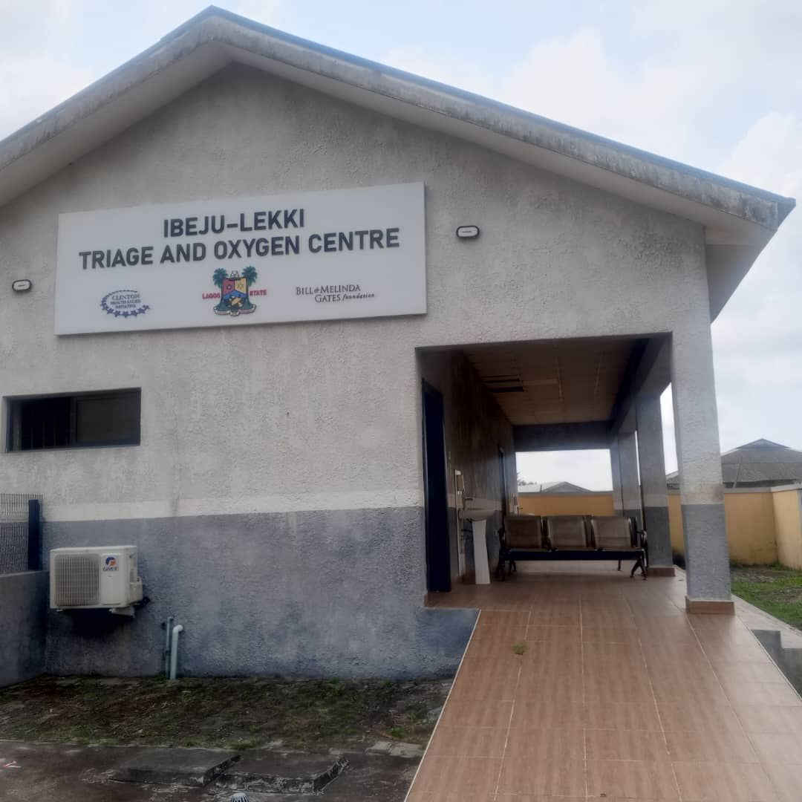
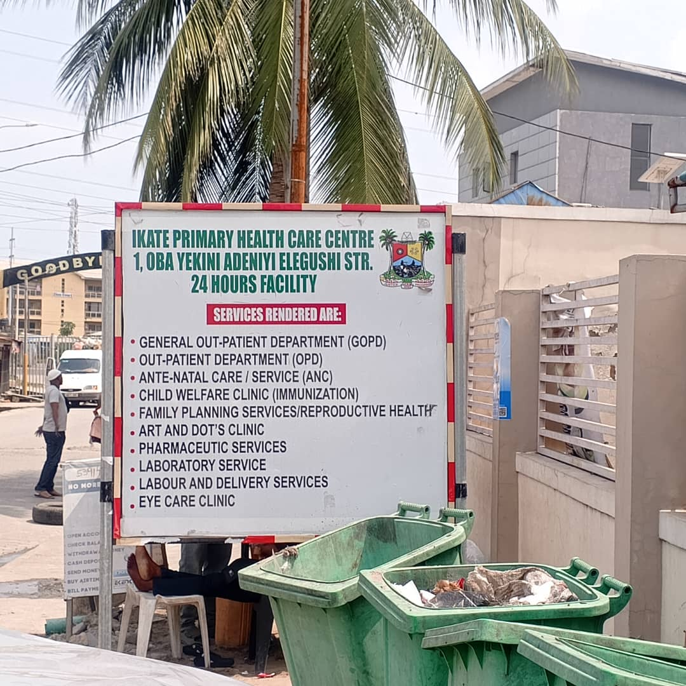
Gallery

Slide 28
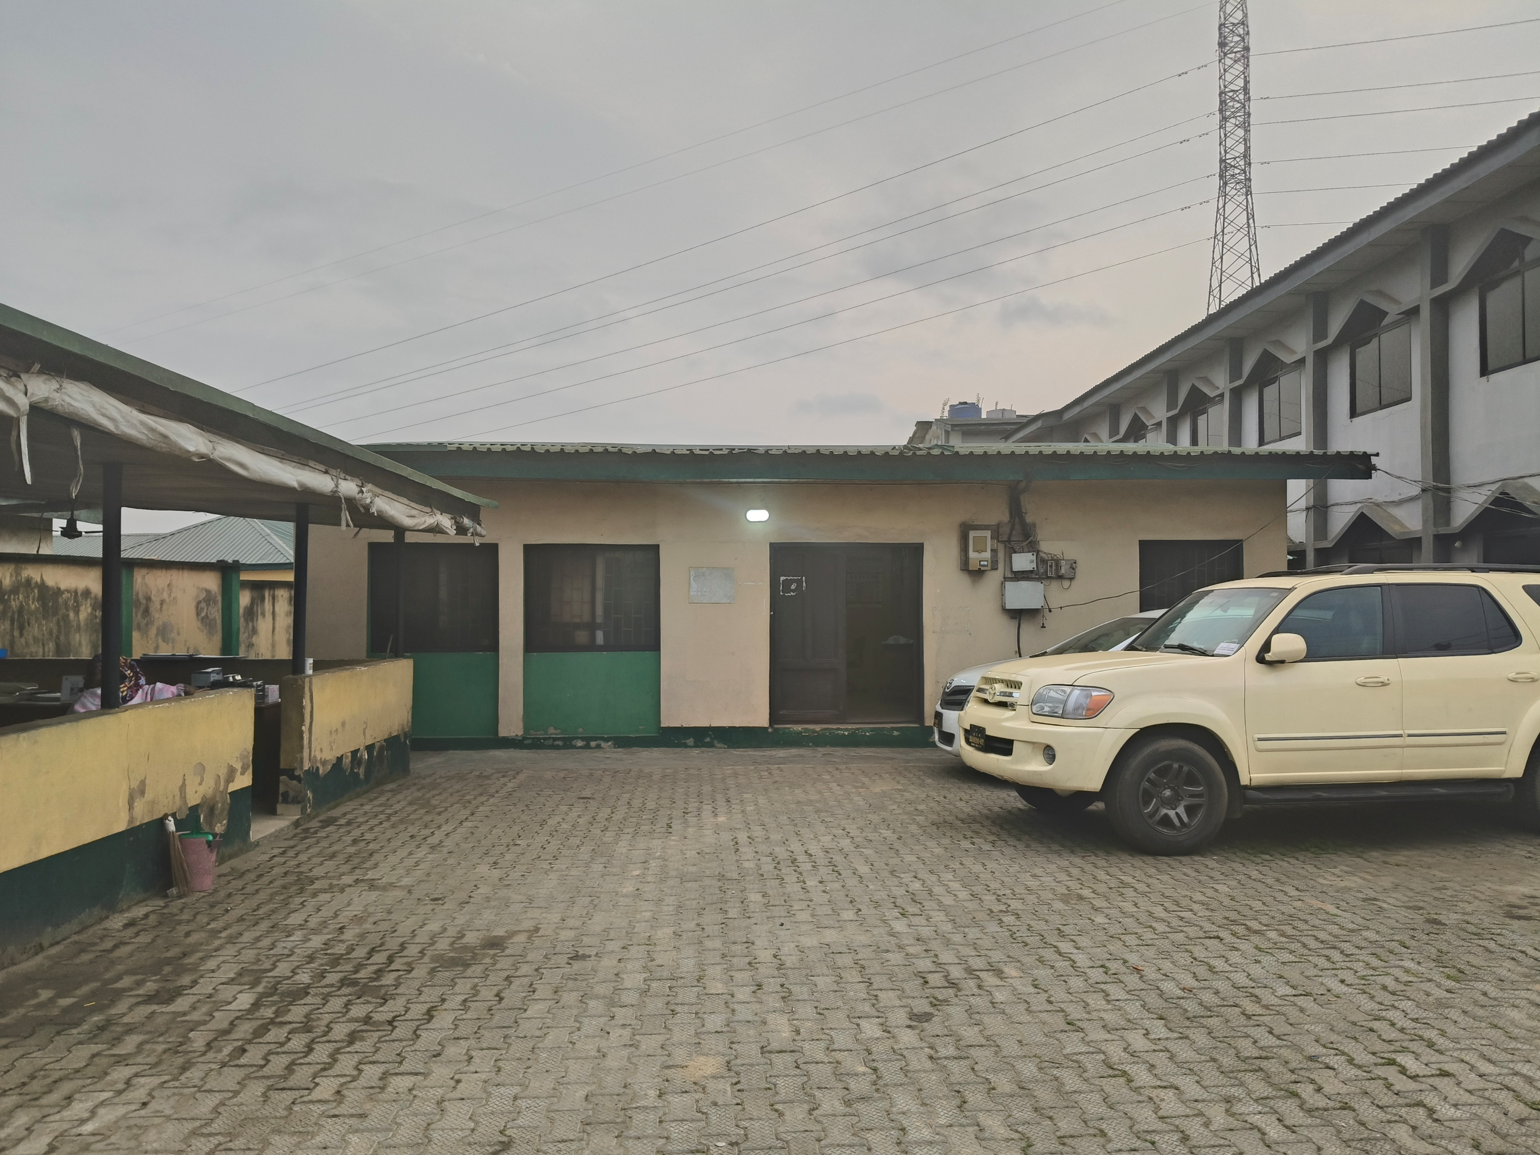
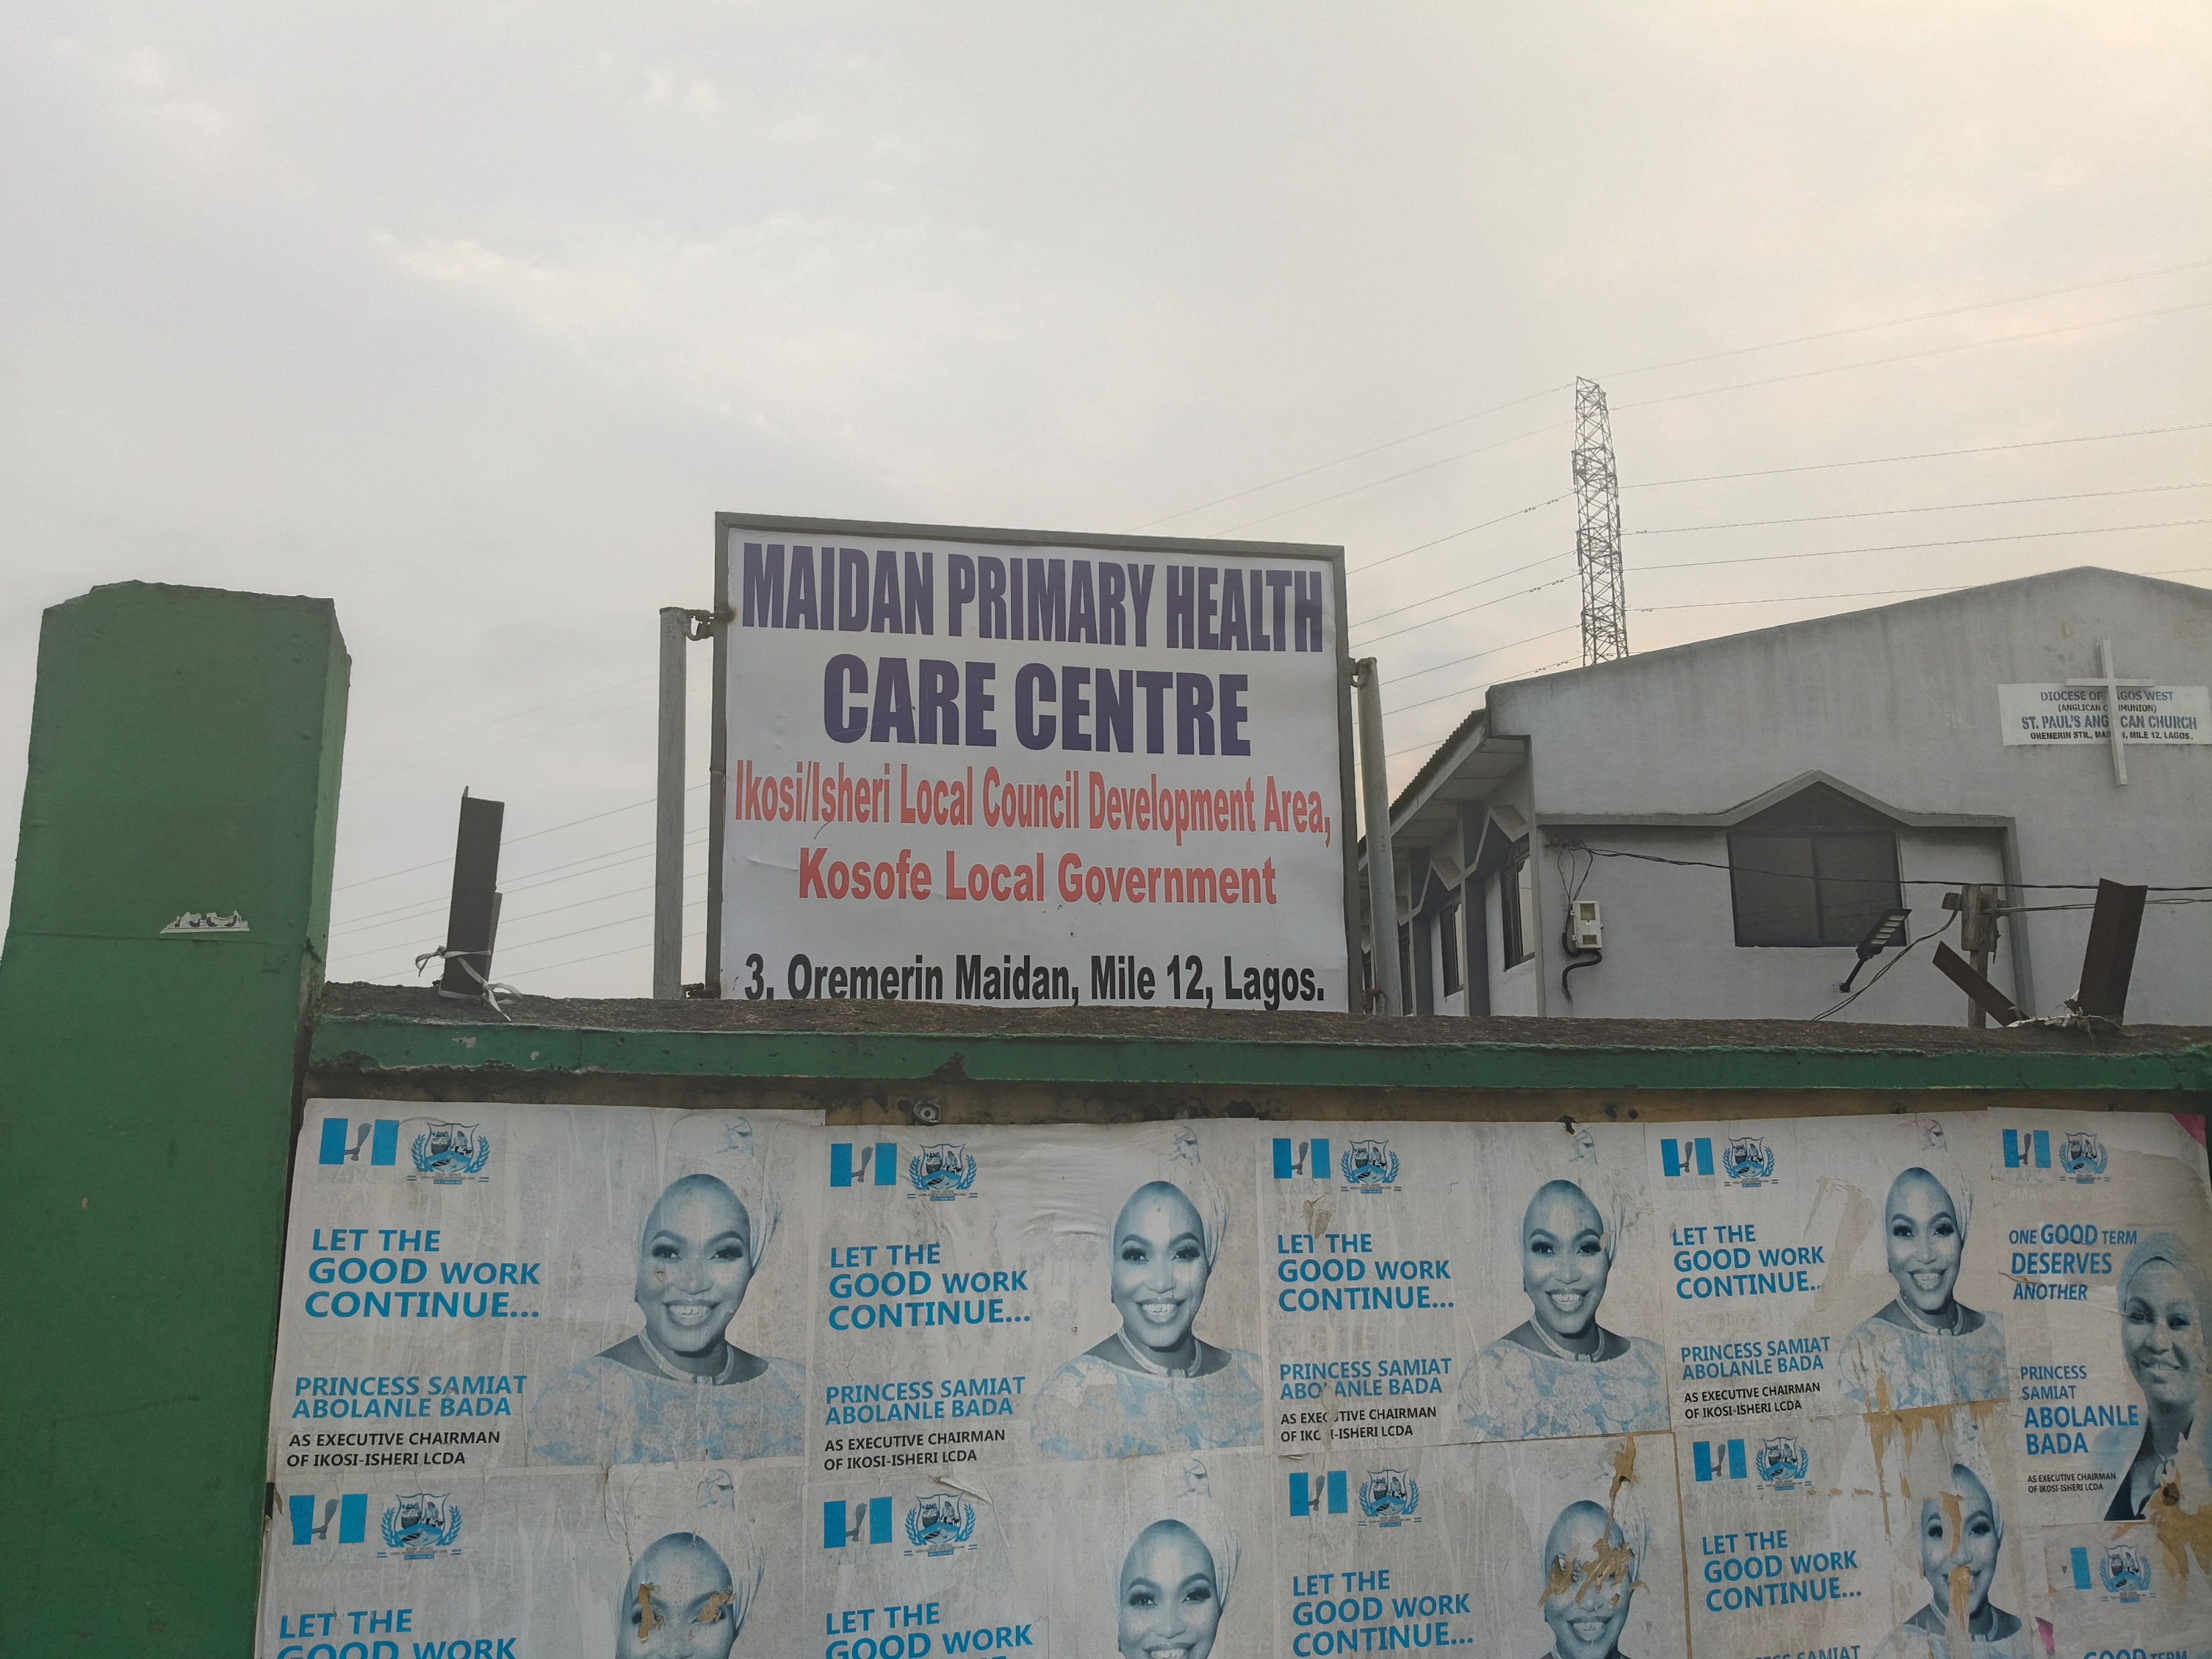
Gallery

Slide 29
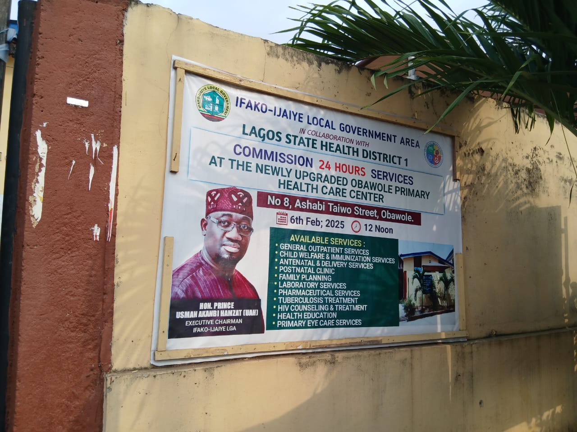
Gallery

